Slide 1
STOCK PRICE PREDICTION USING TIME SERIES

Slide 2
ABOUT US Group Number:01
Name of Team Members:
Shubha Sarkar
Tarak Bharambe
Harshvardhan Shinde
Mohammed Yaseen
Lakshmi Vinisha
Abhishek

Slide 3
About TCS
Tata Consultancy Services (TCS) is one of the largest multinational IT service and consulting companies. It is headquartered in Mumbai, India, but has offices globally. TCS is well known in the e-governance, banking and financial services, telecommunications, education and healthcare markets.

Slide 4
TCS Dataset
Dataset of TCS having stock details from 2002 to 2024.
Size of dataset in rows and columns:(5325,6)

Slide 5
EDA
First, the null values were checked and were filled using the interpolate method.
Then detect the outliers, and remove them using IQR method.
Then checked for the skewness, and transformed the dataset for reducing the skewness.

Slide 6
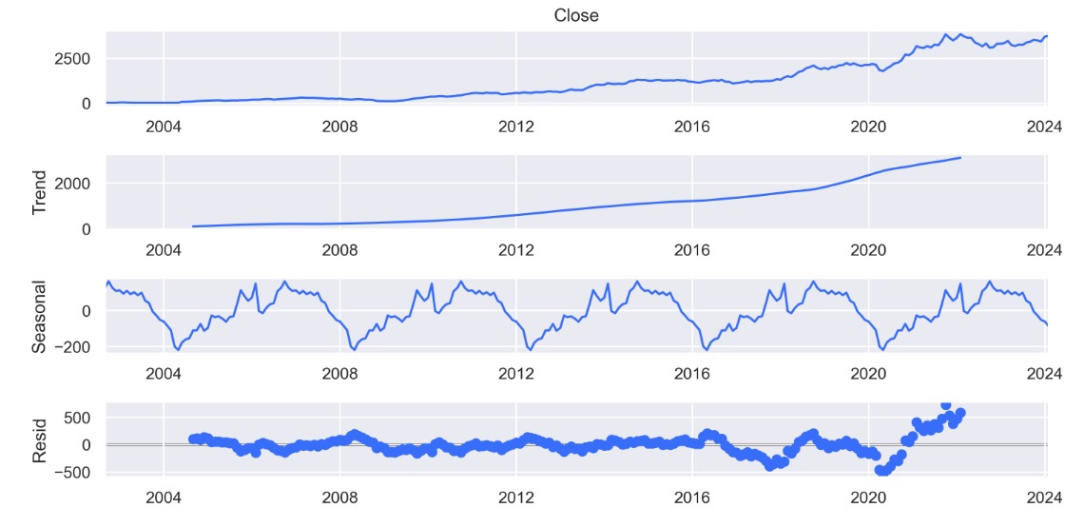
Data Visualization

Slide 7
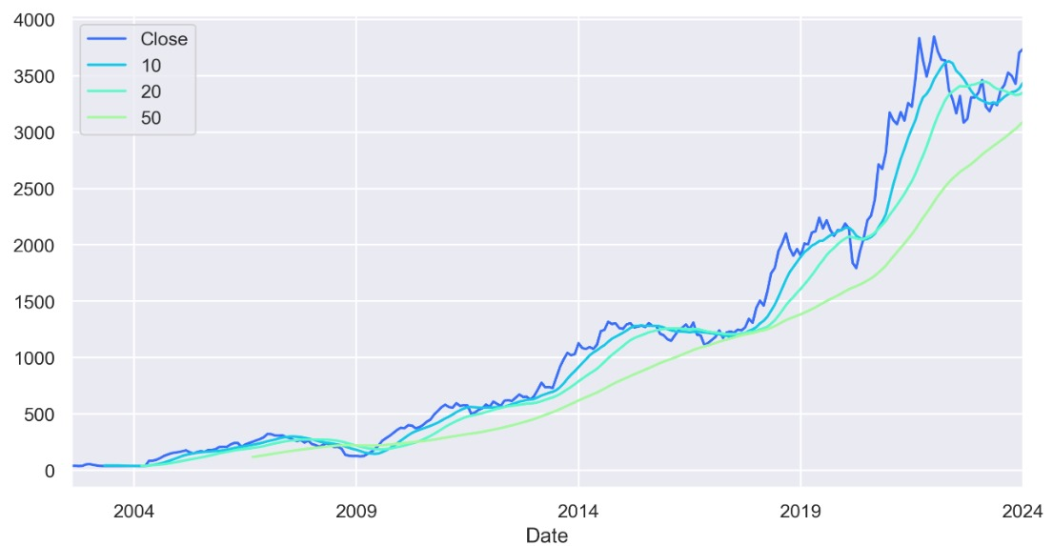
Moving Average

Slide 8
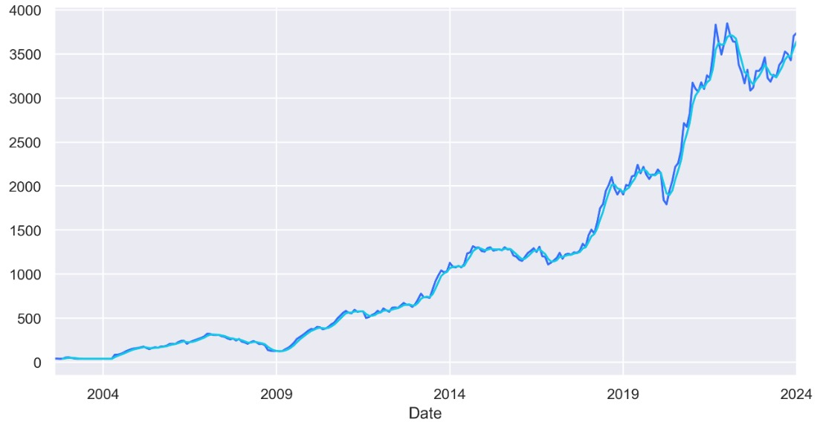
Weighted Moving Average

Slide 9
Model Building
Three types of model were build
Linear Regression Model
ARIMA Model
SARIMA Model
The RMSE for Linear Regression Model – 8.334166
The RMSE for ARIMA Model – 157.30522
The RMSE for SARIMA Model – 21.3748
As RMSE value for Linear Regression Model is least we it for the deployment part.

Slide 10
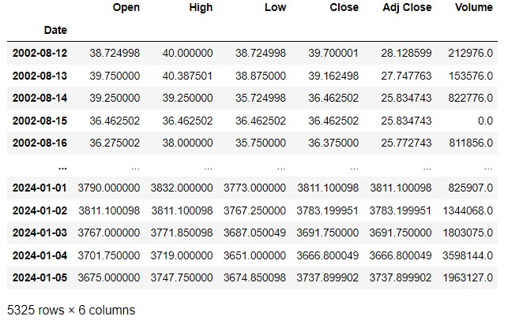
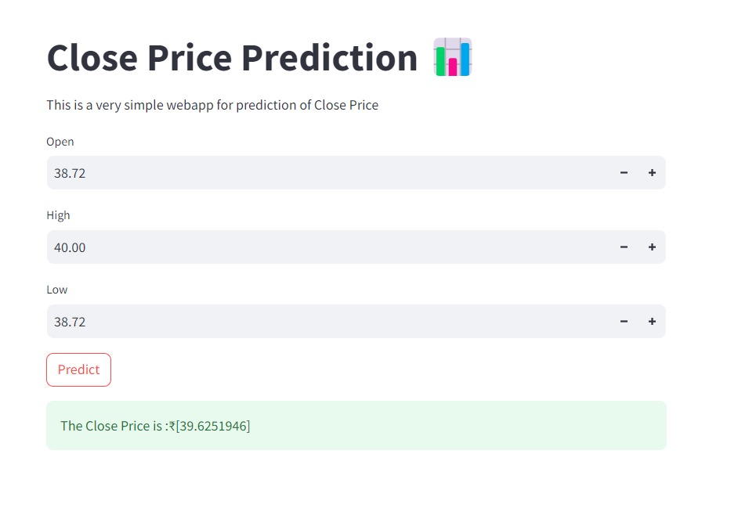
Deployment
Deployed the Linear Regression Method by using Streamlit.

Slide 11
Thank You

